Slide 1

Creating the Vision
NCEA conference
March 29, 2016
Notes:
1) If you’re a Google Apps admin, you can use the API to
- create classes and populate rosters on behalf of your teachers (before school year starts)
- sync rosters from student information systems (keep them up to date throughout the school year)
2) As a developer of any teaching tool, you now have access to these rosters by using the Classroom API.
- So instead of a complex setup, with hard-to-enter class codes, now it’s a seamless transition between the data stored in the school’s SIS, Classroom, and your app.
- And you can help the millions of teachers and students who are already using Classroom by not asking them to keep yet another roster up to date somewhere else.
3) Admins are responsible for how data is shared within and outside their domain, so they’ll be able to restrict whether teachers and students in their domain can authorize apps to use their Classroom data.
- And just so everyone is clear, third-party apps are never permitted to resell Classroom data or use it for any advertising purposes.
My wife is an English teacher, and she’s always telling me to “show, don’t tell”. So instead of more telling, we’d like to show you 3 demos that exemplify what’s possible with the API. In the interest of time, we’re gonna give them 3 minutes each… Speed demos!

Slide 2

Michael Casey
35 Years in Education:
Teacher, Resource Teacher, EdTech Program Manager,
Executive Director IT
Author: N3XT Practices, VISION
President/CEO Eire Group

Slide 3

Why are we here?
Notes:
What’s your expectation in attending this academy? Bought tech for SBAC?
Why a Team? What does your team look like?

Slide 4

Notes:
When it came to writing - this was me in school
cumbersome, painful, hated to edit, hated to re-write (in fact wouldn’t do it), wouldn’t want to share my work
not good at it!
If it wasn’t for wood shop i don’t know if i would have finished high school
loved math and science - how do we make school for EVERYONE
the two smartest people i know ….

Slide 5

Iteration, innovation and
transformation in education

Slide 6

21st Century Skills
21st Century Jobs
@jcasap

Slide 7

Communicate

Slide 8
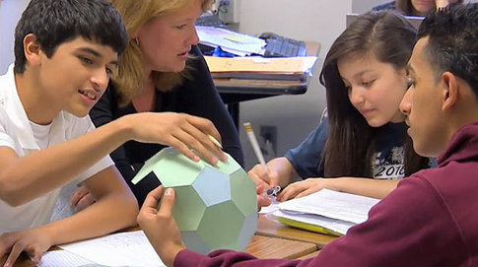
Collaborate

Slide 9

Creativity

Slide 10

Critical Thinking

Slide 11
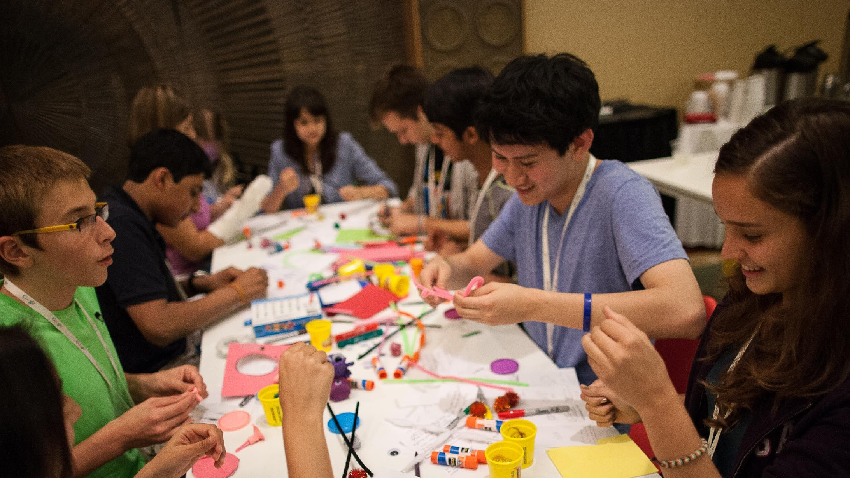
science of learning…
@jcasap

Slide 12
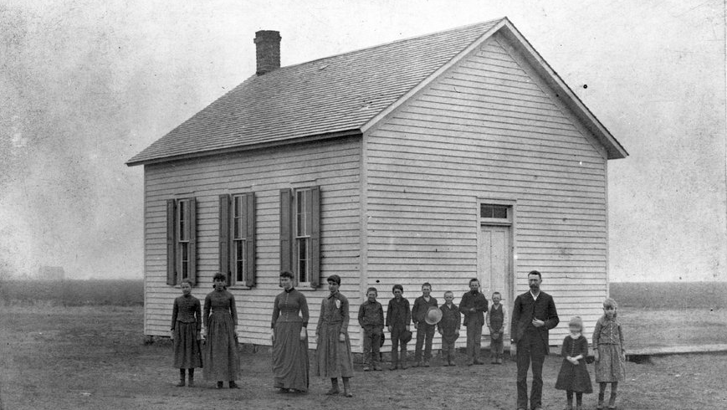
we are using a system we implemented in 1820
@jcasap

Slide 13

the world at your fingertips…
@jcasap

Slide 14

what problem do you
want to solve?
What Problem do you want to solve?
@jcasap
Notes:
google science fair winners “quote from Jamie”

Slide 15

Notes:
Don’t start your journey with “it’s not my job”
Build the right team
Take responsibility

Slide 16
Considerations:
Curriculum
Applications
Devices
Professional Development
Infrastructure
Wireless
Physical Spaces
Sustainability
Evaluation
Communication

Slide 17

The Impetus for Creating an Education Technology Vision
Notes:
State/Federal Requirement, Grant, endowment, board communication, public, bond

Slide 18
Responsibility for the Vision
Notes:
superintendent

Slide 19
How the Vision Supports the Organization
Focus
Validates Actions
Supports Long and Short-Term Decision Making
Digging Out
Funding
Proactive Engagement
Instruction

Slide 20
What is Your District’s Vision
What are students doing?
Teachers?
Principals?
If a visitor walked onto campus, what impression would they have?

Slide 21
A Curriculum Approach to Technology Integration

Slide 22
The most important relationship in your organization that will help ensure successful technology integration, is that between Curriculum and Instruction and Information Technology.

Slide 23

Why we hate IT
They won’t let us do what we want
They don’t speak our language
Everything costs too much the way they want to do it - can’t I just go to Fry’s
Everything takes too much time - what’s all this planning about?

Slide 24

Focus on Curriculum Initiatives, not Technology Initiatives.
Notes:
So really the incorporation of technology, and I can't stress this enough, began with curriculum and instruction, not technology
We did not acquire technology, then try to figure out the purpose for having the technology
We were clear and intentional about our instructional focus and THEN, determined the need for technology
Great quote by Alan November: 'Technology is often a solution looking for a problem'... this is backward implementation model
Technology and and C&I in a collaborative relationship: DO NOT want to create instructional competition between technology and content

Slide 25
Strategic Planning
3 Core Areas
Curriculum and Instruction
Technology
Professional Learning
Notes:
Facilities, Budget, Communication, External Resources

Slide 26
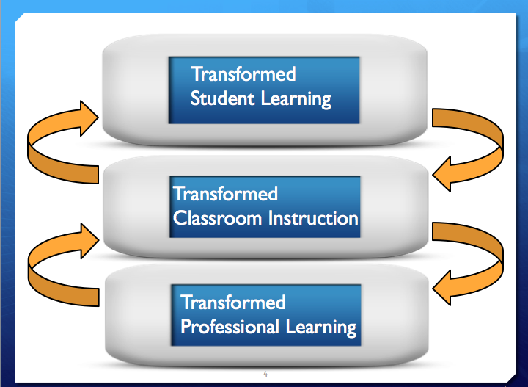
Notes:
Improving student learning and achievement is at the center of all our district decisions
Slide by Joellen Killion illustrates the interconnectedness between professional learning, classroom instruction and student learning.
This approach, you'll see later, is the same for incorporating the technology into classrooms with 1-1 student devices

Slide 27
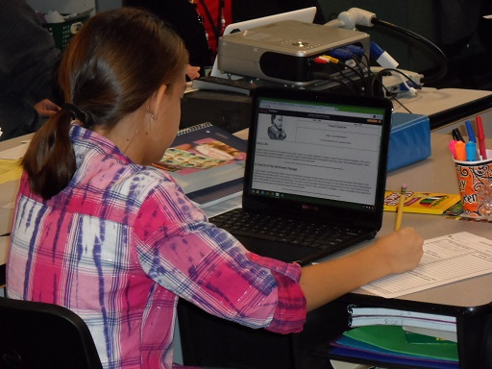
Laser Focus and Commitment
Common Core Standards
Writing
Professional Learning Model
Writing, Technology, 21st Century Skills
Notes:
A lot of distractions exist in education, but with a determined Focus and Commitment to on writing
We are tying effective instructional practice to CCSS and student learning reflective of CCSS
Need for high quality professional learning cannot be understated:
Incorporated the writing and technology
addressed the rigor in the form of student thinking reflective of 21st century skills, skills which can't be misinterpreted to solely imply the use of technology:
It's the USE of technology to foster critical thinking, communication, collaboration, and creativity

Slide 28
Professional Learning
40 Hours/Teacher
Summer
Substitutes
Conferences
Notes:
30 minutes on devices - 39.5 hours on integrating curriculum

Slide 29
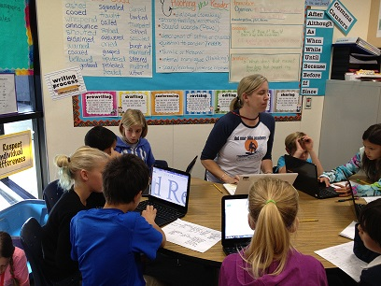
Tools to Support our Curriculum Focus
Google Apps For Education
Writing Process
Collaboration
Sharing
Teacher and peer comments
Publishing
Presentations
Spreadsheets
Communication
Notes:
MIKE
storyboard, pre-write, write, re-write
students collaborating on an assignment - supports project based learning - learning in a performance team
sharing with teacher, peers, team partners
comments
publish via presentation, sites
everything supports communication about their learning and making their work public

Slide 30
One-to-One Devices
What does it mean to you.
Notes:
BYOD?
When you need it?
Give a device to everyone?

Slide 31

Chromebooks
Tool to evaluate technologies
Cost, Ease of use, IT support, Functionality with GAFE
Wireless Infrastructure
Notes:
Process for selecting CB
Curriculum focus first - WRITING
Apps to support the writing focus
The tool that we developed to help evaluate technology - we were a Mac centric district

Slide 32
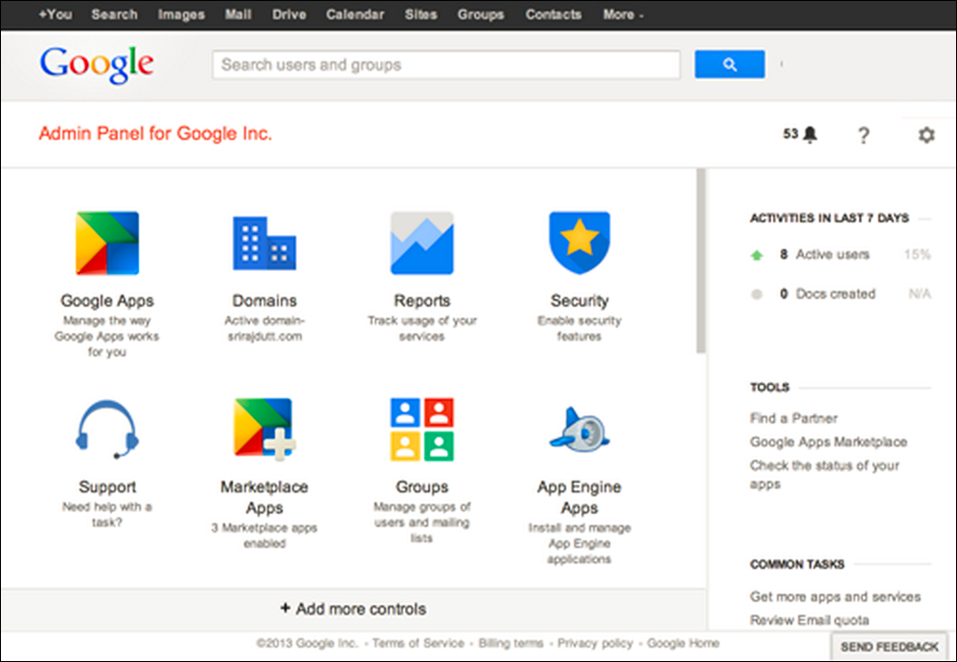
GAFE Management Console

Slide 33
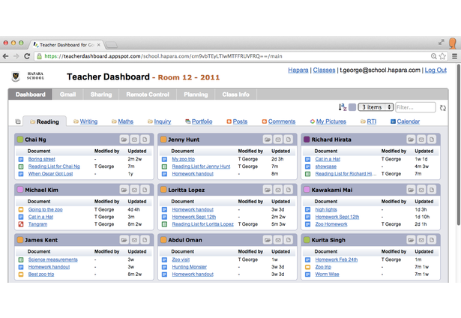
Hapara Teacher Dashboard

Slide 34



Technologies to Support our Initiative
UMRA (tools4ever)
Hapara - Teacher Desktop, Remote Access
Backupify
Notes:
MIKE
UMRA is a provisioning tool - student-> AD->google + Hapara
Hapara - teacher desktop - remote access - see all docs whether or not they are shared
Backupify - backs up all google docs, presentations, spreadsheets, sites etc. 3 times a day - end user can restore

Slide 35
My Philosophy
"One-to-One is not about the ratio of devices to students. It's about the interactions a teacher has with each student."

Slide 36

Going Google

Slide 37
Ready to launch?
Domain(s), Email
GAFE
Provisioning Accounts
Training: IT Staff, Teachers
Professional Development: Integration
Supports
Deployment

Slide 38

Infrastructure
In Support of instructional Practice

Slide 39
Enterprise Strategy
(You’re running a business)
Standardize
Infrastructure
Devices
Future Proof
Processes – How we do things.
Support
Training/Professional Development

Slide 40


Wireless

Slide 41
End User Devices
Were not always very good at predicting the future, however we can say with confidence:
That future devices will be Wireless and Mobile.
We will require more bandwidth
Without a robust wired infrastructure in our schools, wireless is useless.
Notes:
Support media Rich applications, Video streaming, Khan Academy(ish)

Slide 42

Proliferation of Mobile Devices
A full 70 percent of CIOs surveyed cited mobile technology as the most disruptive digital technology in the enterprise (Gartner)
There are over 1.2 Billion people accessing the web from their mobiles. Over 300,000 apps have been developed in the past 3 years
In the U.S. 25% of internet users are mobile only.
Notes:
2/3 of the world is still not connected to the internet – what’s going to happen then?

Slide 43

Future Proof Infrastructure
How do we build an infrastructure that we don’t have to upgrade all the time?
Can we build an infrastructure that is malleable?
How far in the future can we see? What is the source of that information?
Notes:
Malleable – one that we can change over time or adjust as new technologies emerge or a demand arises. Add modules to.
Can we trust the vendor community?
- Once again having a Strategic Plan in place will help greatly

Slide 44
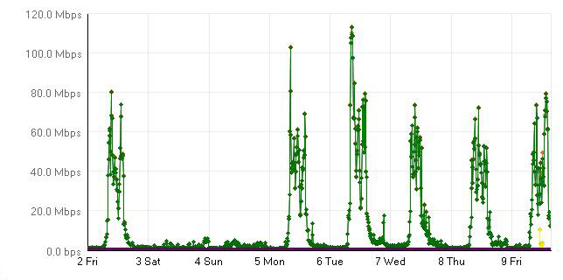
Bandwidth Sample Before SBAC Testing

Slide 45
Bandwidth Sample During SBAC Testing
Notes:
There was no change
Shouldn’t be one if your students are already using tools to support instruction

Slide 46
Upgrading
Upgrading Wireless/Bandwidth should be about Instructional needs.
You may not need to upgrade for Smarter Balance Assessments.
Measure what you are doing.

Slide 47
Wireless Considerations
Wireless is no longer a luxury and needs to be implemented using enterprise strategies and techniques.
Readiness (Checklist)
Density
Bandwidth and Access Points
Management, Monitoring
Homogeneous Environment
Notes:
Readiness
Common Vision
C&I and Technology - OrgChart
Understanding the instructional needs
What are the goals for your implementation or upgrade
What is your current wireless environment
Platform, Capacity, Density
What tools are you using

Slide 48
Wireless Density: Coverage vs. Saturation
Coverage
I can walk around my school site and stay connected wherever I go. If I walk into a classroom where a number of students are also connecting to the wireless, I may lose my connection, or performance is poor.
Saturation
I can walk around my school site and stay connected wherever I go. If I walk into a classroom where a number of students are also connecting to the wireless, I don’t lose my connection, and performance is good. Thirty more students can enter the room and everyone can connect, and performance is good.

Slide 49
Management of Wireless
Wireless Controllers – Manage the configuration of all of your Access Points.
Centralized
Localized
Load Balance
Redundancy
Notes:
Old School – redundant wireless controllers in the data center
New School – redundant wireless controllers at the school site – optional module within the switch

Slide 50


Monitoring
Network Utilization
Devices: Servers; Access Points
Solarwinds
Wireshark

Slide 51
Wired Infrastructure
Without a robust wired infrastructure, wireless is useless.
Pathway
Cable Plant
Switching and Routing
Redundancy
Power
Firewall
Filtering
Core Switches
Data Center
ISP

Slide 52
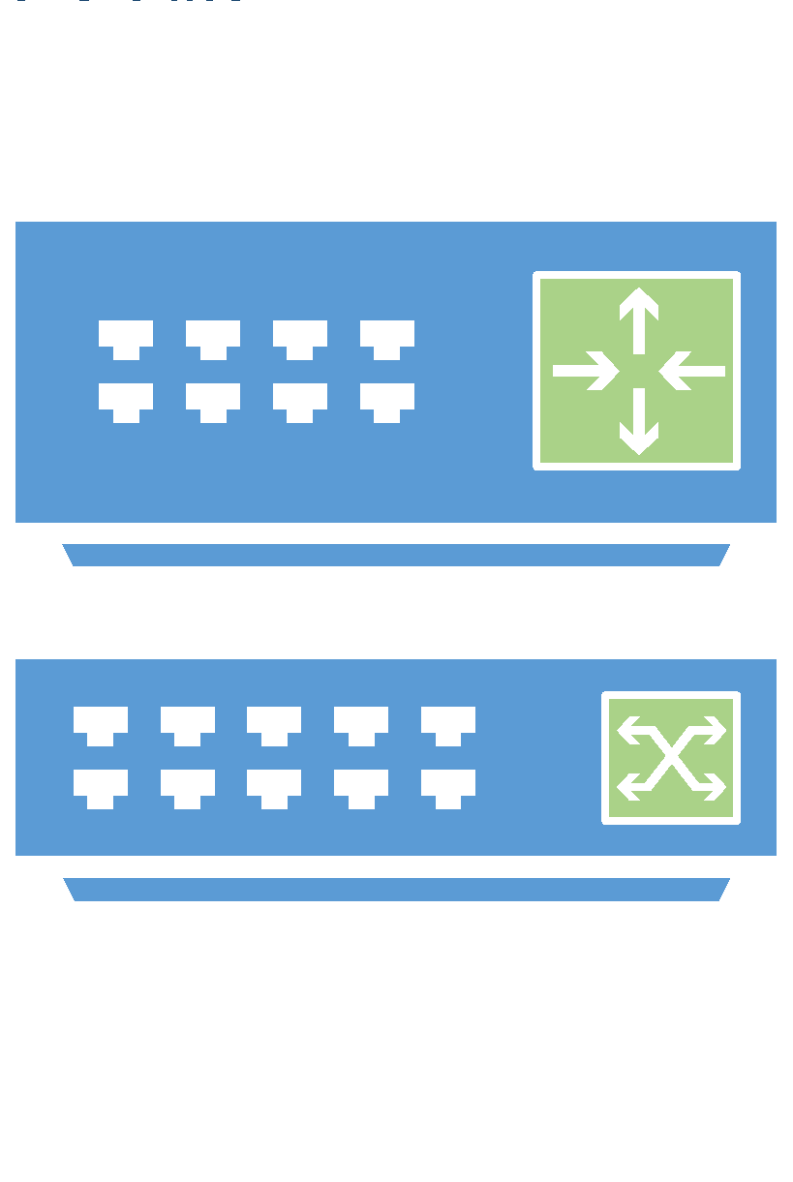

What does it look like?
School/Classroom Connections
MDF
IDF
Fiber
802.11ac = 1Gb
10 Gb POE
Fiber
10 Gb POE
IDF
10 Gb POE
Notes:
Move to 10 Gb at the core

Slide 53
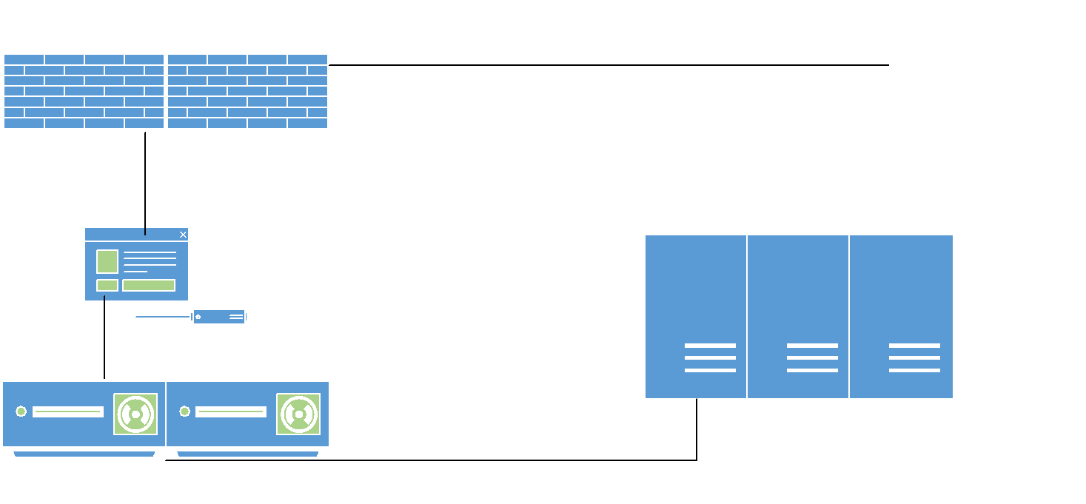
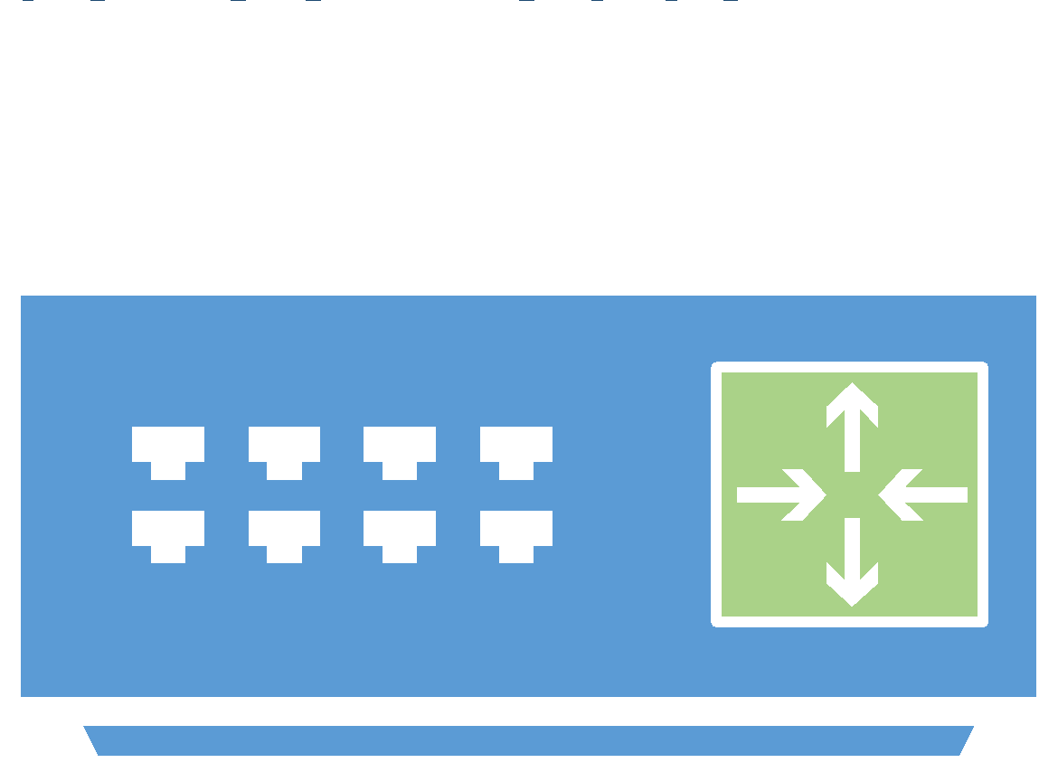
What does it look like?
District MPOE
1-10Gb Fiber
1-10Gb Fiber
10 Gb
Notes:
1-10 Gb Fiber = build your network to support 10Gb even though you may only need 1Gb now

Slide 54

Your Infrastructure?
IT folks do an assessment and share with your team
What do you need to do today?
What is your refresh strategy?
Notes:
Open Systems Interconnection

Slide 55
Get Help
When designing a network infrastructure, ask experts in the field.
If you can describe functions/applications they can design it.
Where can you get help?
Vendors
Consultants
County Office of Education
Notes:
With Vendors and Consultants – be sure to avoid any conflicts of interest.

Slide 56

Physical Space
FLEXIBLE!
Ability to make work public (Projectors vs TV’s)
http://groupwerk.net/
https://www.youtube.com/watch?list=PLE7OYmYUxGQdtFNk23nKK9ODudtvcQCgn&v=4cscJcRKYxA
Notes:
Get input from districts - brainstorm

Slide 57
Physical Space
Watering Hole
Cave
Campfire
Mountain Top
Sage on Stage
Guide on Side
Sand Pit
Flipped Classroom
Notes:
Watering Hole
Here you: come together to exchange ideas and cross-pollinate.
Think: a student learning programming and a student learning to dance sharing ideas about the creative process while having a drink.
Cave
Here you: withdraw from the noise of the classroom to be alone with your thoughts and reflection. A place to explore questions and make connections.
Think: a beanbag enclosed by bookshelves.
Campfire
Here you: share stories, exchange ideas and allow the group to build on each others’ ideas.
Think: a group brainstorming ways to advertise their product to the community.
Mountain Top
Here you: celebrate and sharing your learning “one to many.” You “sing it from the mountaintop.”
Think: showing to the rest of your class a summary of your science project findings.
Sand Pit
Here you: play, prototype and experiment without worrying about mess, water or damaging surfaces.
Think: testing your bridge design to see if it can support the weight of a toy car.

Slide 58
OSI+ Model
OSI+ Model - What is the connection between Infrastructure needs and educational technology needs i.e. curriculum needs (slides, discussion)
How does it all fit together?
Notes:
Open Systems Interconnection

Slide 59
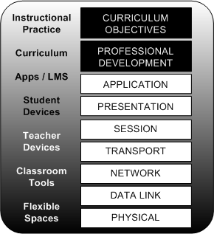
OSI+

Slide 60
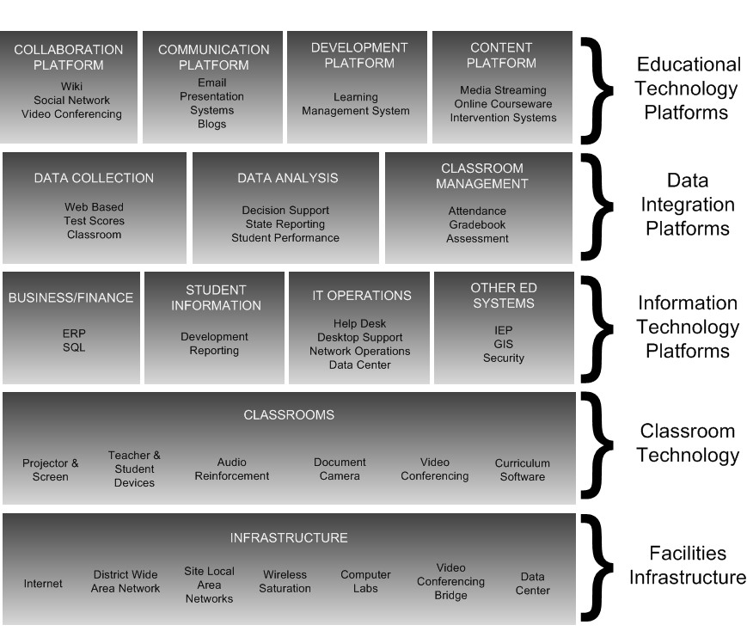
Notes:
Detailed OSI+ model

Slide 61

$u$tainability
Notes:
Costs
Leasing
Flatten your budget
Going Greener

Slide 62
What is your Vision?
What do you want to do?
What problem do you want to solve?
Where do you want to take your district?

Slide 63
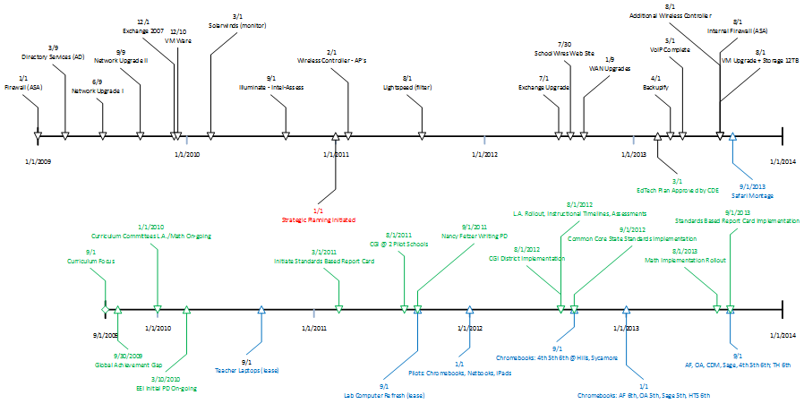
Timeline Development

Slide 64

Action Steps
Notes:
Fill out action steps on your worksheet - be ready to share

Slide 65

Evaluation Tool
Notes:
Can we add to our action step plan?

Slide 66

Communication Plan
Notes:
Discuss at your table - Add to your action steps, who’s responsible?

Slide 67

Michael Casey
mike@eiregroup.com
619-241-9195
Thank you!

